Slide 1
AINR Comparsion
Tuning team

Slide 2
Test_setting
Scene | Exp_gain | Ambient light | Comparsion | Device
lightbox-1 (w/ toy car moving) | 11ms 128x | 10lux | ASR Depthwise Convolutions 旷视(w/o np calibration) | DX board (single frame dump)
lightbox-2 (pursue) | 11ms 128x | 10lux | ASR Depthwise Convolutions 旷视(w/o np calibration) | DX board (single frame dump)
Lab x2 | 11ms 64x | 3lux | ASR Depthwise Convolutions | 软龙格 (continue dump 90 frames)

Slide 3
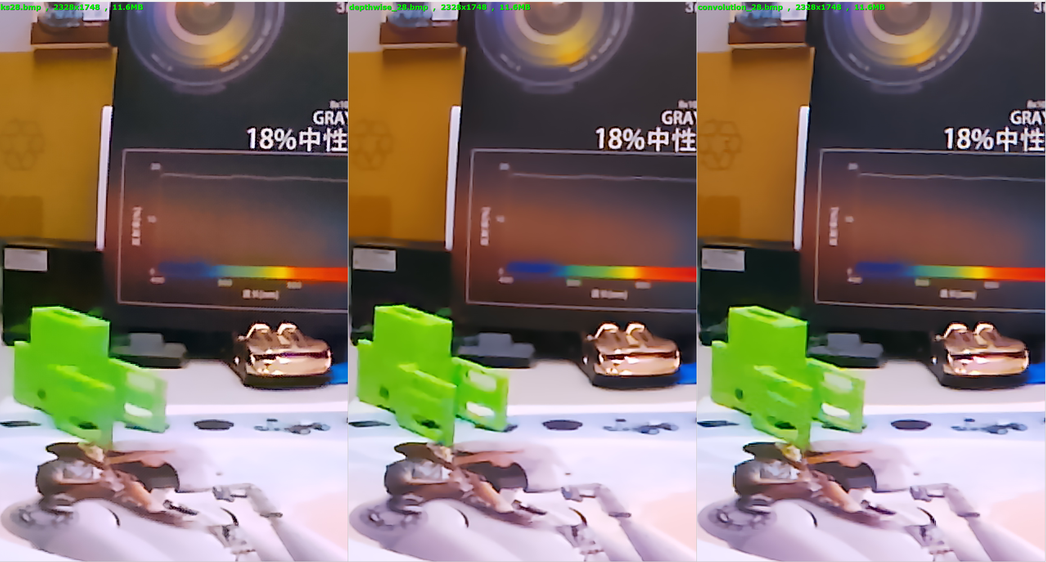
lightbox-1

Slide 4
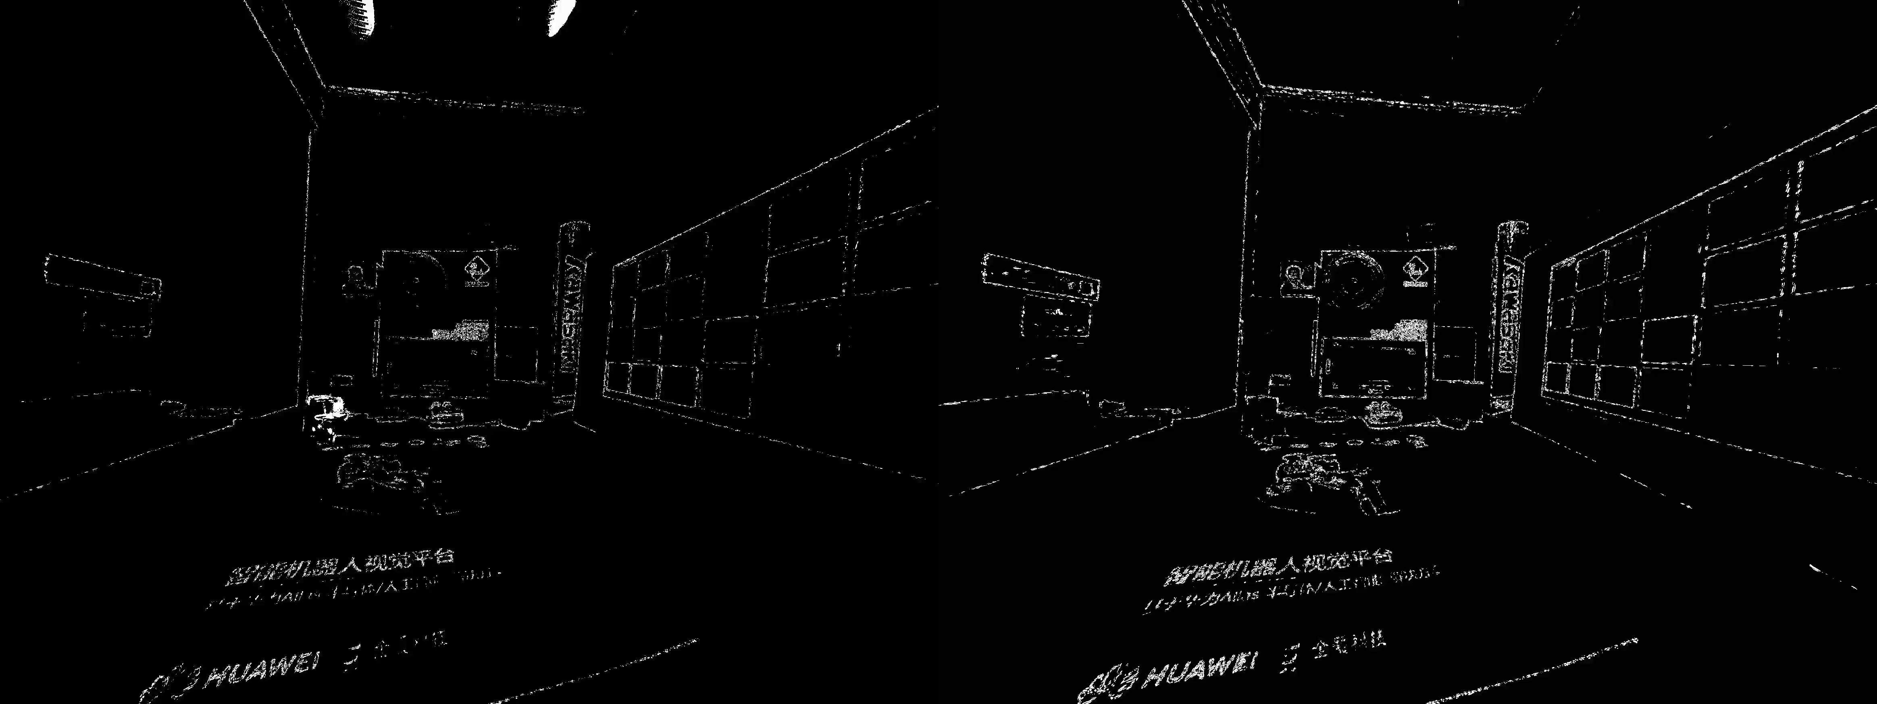
lightbox-1
KS
Depthwise

Slide 5
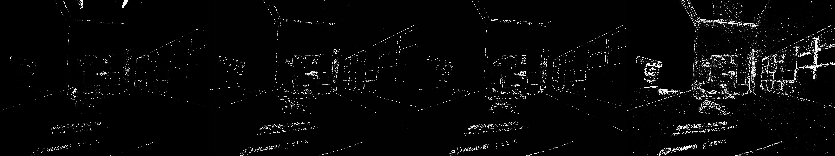
lightbox-1
KS
convolution
depthwise
asr

Slide 6
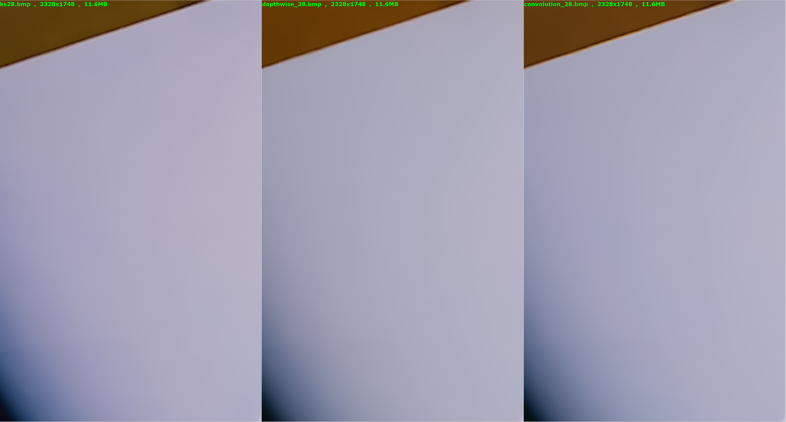
lightbox-1

Slide 7
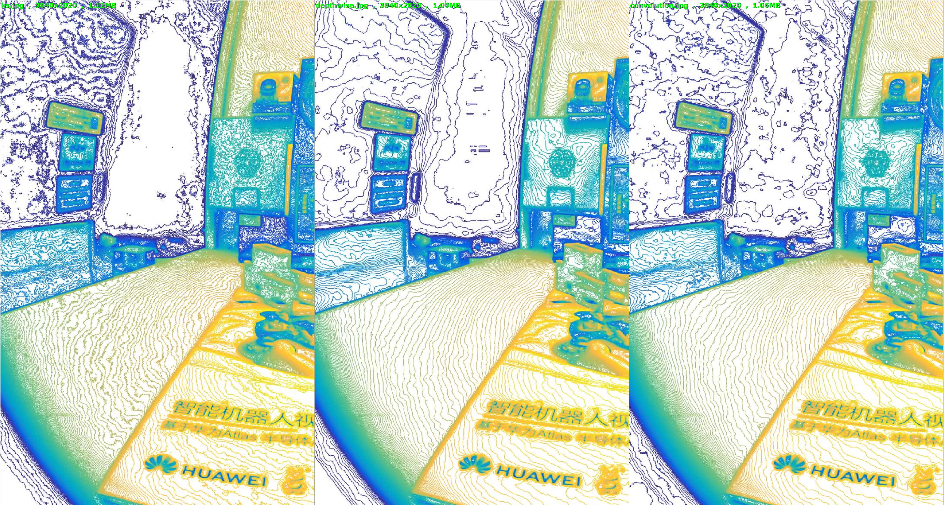
lightbox-1

Slide 8
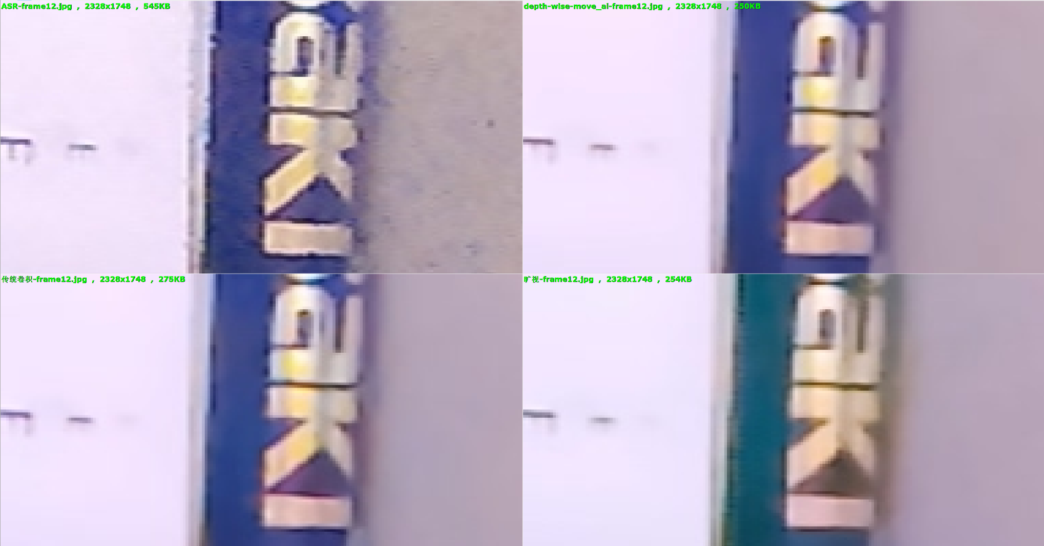
lightbox-2

Slide 9
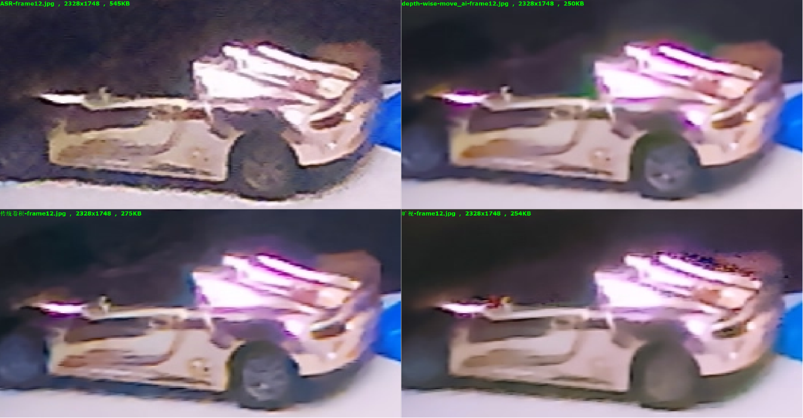
lightbox-2

Slide 10
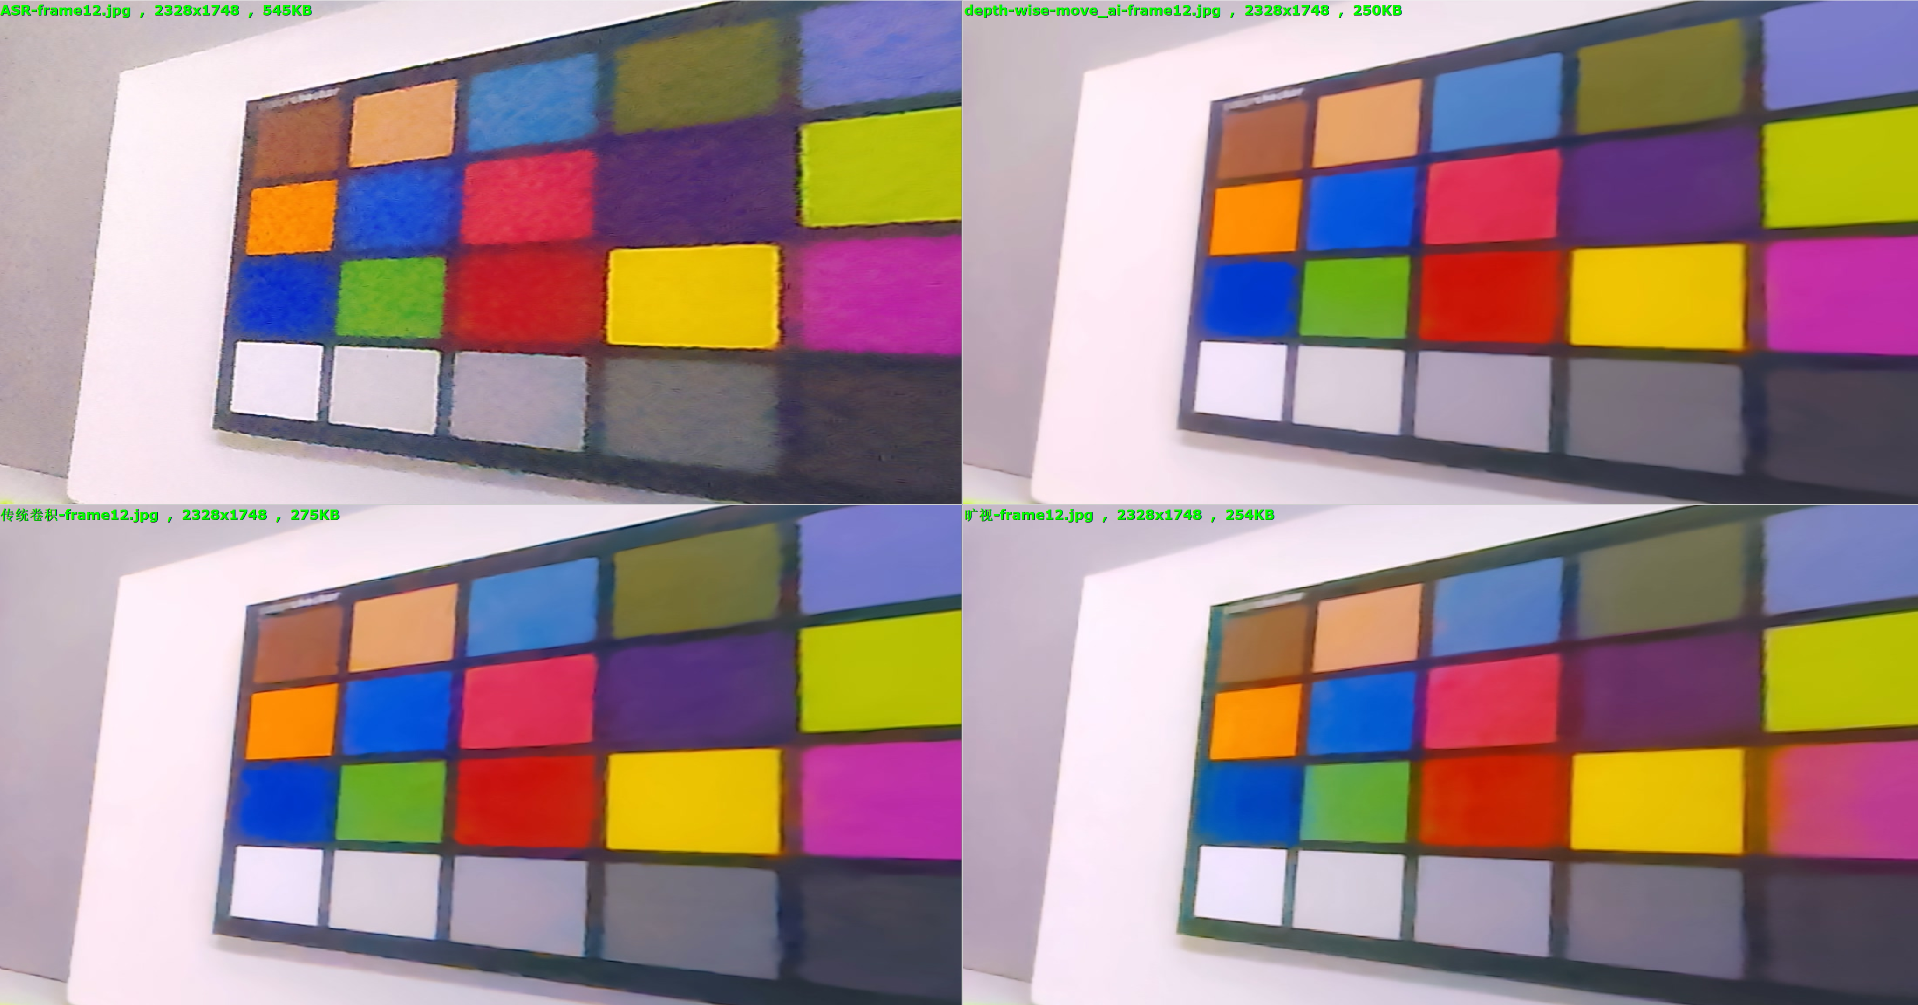
lightbox-2

Slide 11
Conclusion
Algo | Temporal NR | Texture | Contrast&Color
旷视
Depthwise
Convolution
ASR

